Slide 1
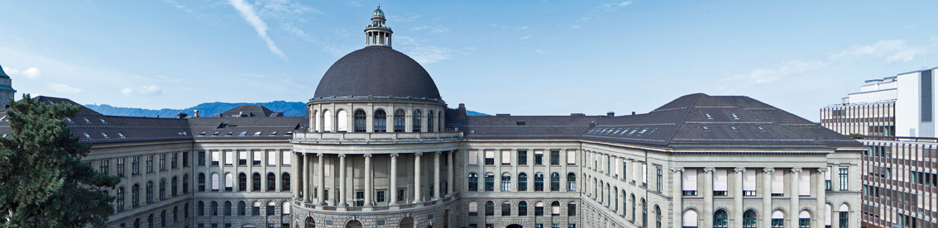
Implementation of a Traffic Light System at the Tannenbar-Intersection
Team Tea-Tan: Nico Burger, Leo Fent, Jérôme Landtwing, Pascal Lieberherr
Notes:
- Hello everybody and welcome to our presentation
- We are the team tea-tan namely we are Nico, Leo, Jérôme and I
- Let's get started with our motivation for this project which is called implementation of a Traffic Light System at the Tannenbar-Intersection

Slide 2
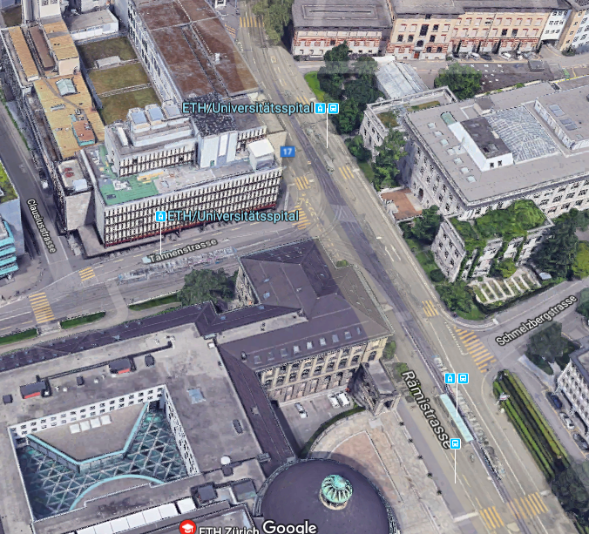
Introduction / Motivation
Key Questions:
How good is the current solution?
Could the situation be improved by adding traffic lights?
What would be the best solution for all agents?
Notes:
- To understand our motivation and our goal just simply imgaine you whats going on during lecture breaks at the tannenbar crossroad
- By the way the Tannenbar Intersection can be seen on the picture on the left
- Well whats going on there during lecture breaks or during the rush hour?
- Pedestrians keep crossing the streets while the cars start to line up this results in a congestion and thus long waiting times for the cars.
- Since we face this situation close to everyday we asked ourselfes wheter a traffic light system could help to significantly reduce the cars waiting time while pedestrians only have to wait a little bit
- To find out if traffic lights would make sense we posed three key questions:
1.
2.
3.
No let me hand over to the next speaker who's going to explain you our simulation more detailed

Slide 3
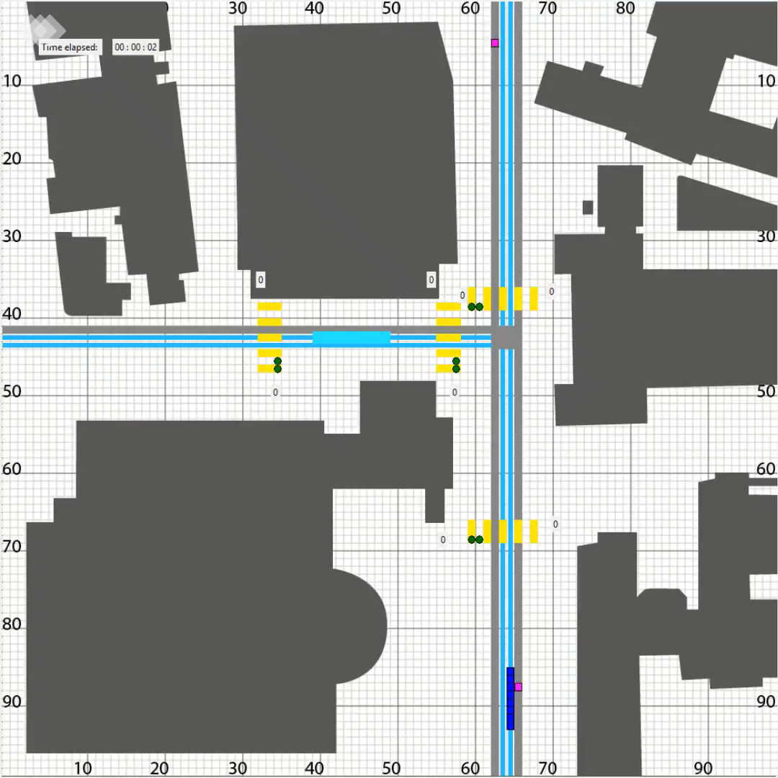
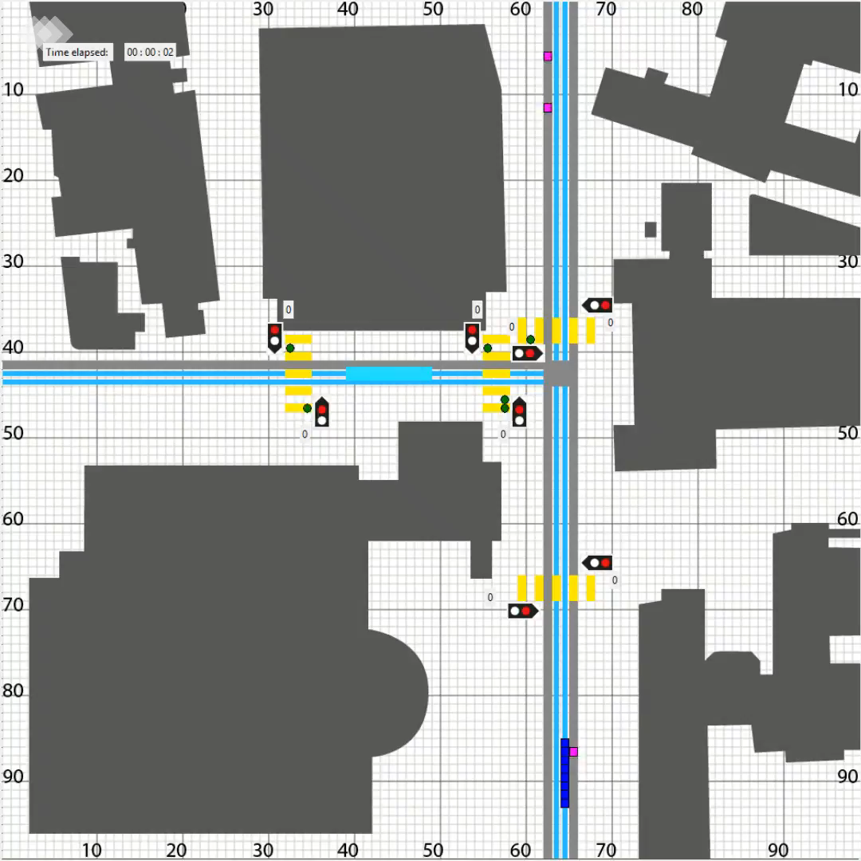
Simulation
Without Traffic Lights
12:00 lunch-time
Including Traffic Lights
12:00 lunch-time
Pedestrian
Car
Tram
Notes:
To find the results, we performed simulations:
Modeled Intersection
Agents (vgl real life)
Two basic distincions:
With and without lights

Slide 4
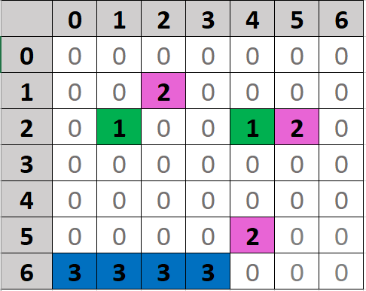
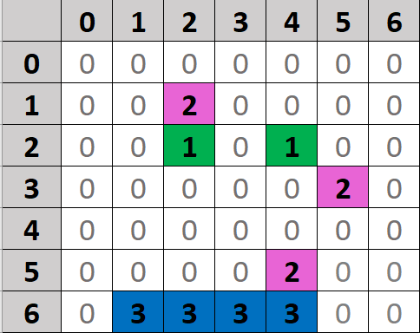
Simulation
Cellular Automata (Rules)
Waygiving Hierarchy
Pedestrians
Trams
Cars
Occupied Squares → no move allowed
Spawning
Given Path
Spawned at Startingposition
Deleted at Endposition
Notes:
Model using cellular automata
Attributes of agents erklären
Spawning / paths

Slide 5
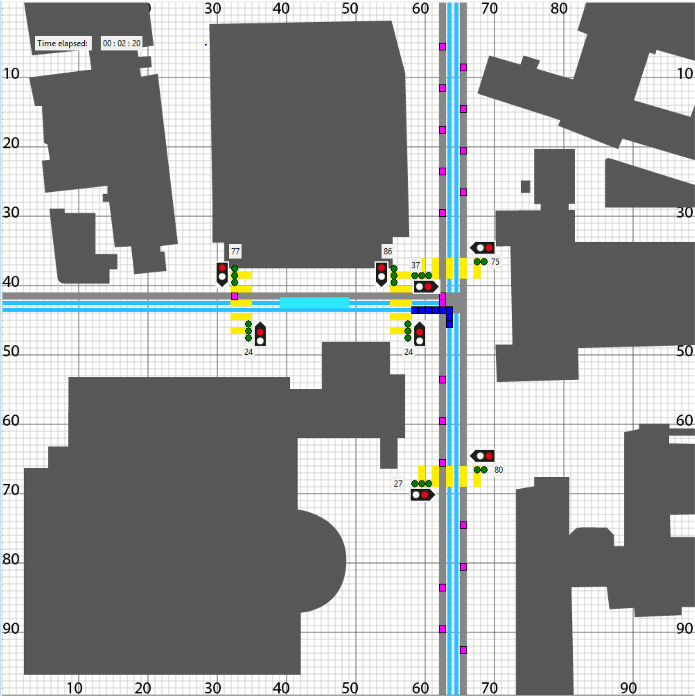

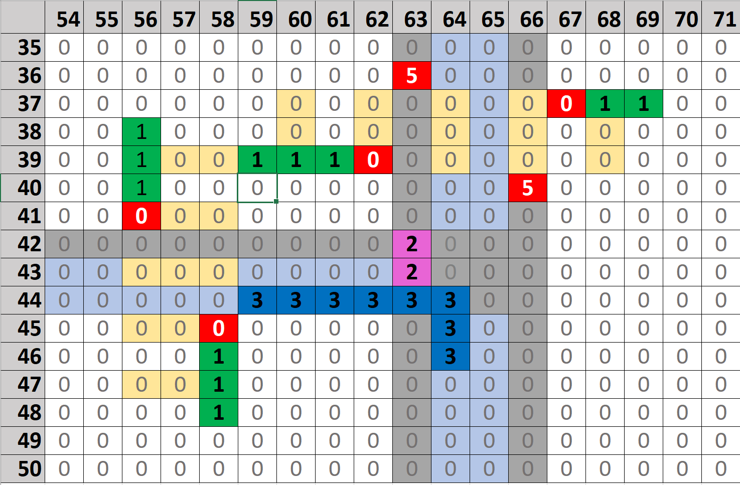
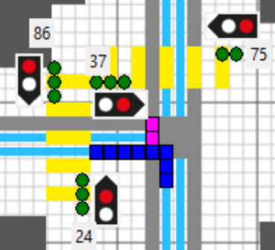

Simulation
Matrix
100x100
Keeps track of Agents
Entry | Meaning
0 | Empty
1 | Pedestrian
2 | Car
3 | Tram
4 | Pedestrians Wait
5 | Cars Wait
Notes:
Base of everything is a matrix
- Keeps track of free positions

Slide 6
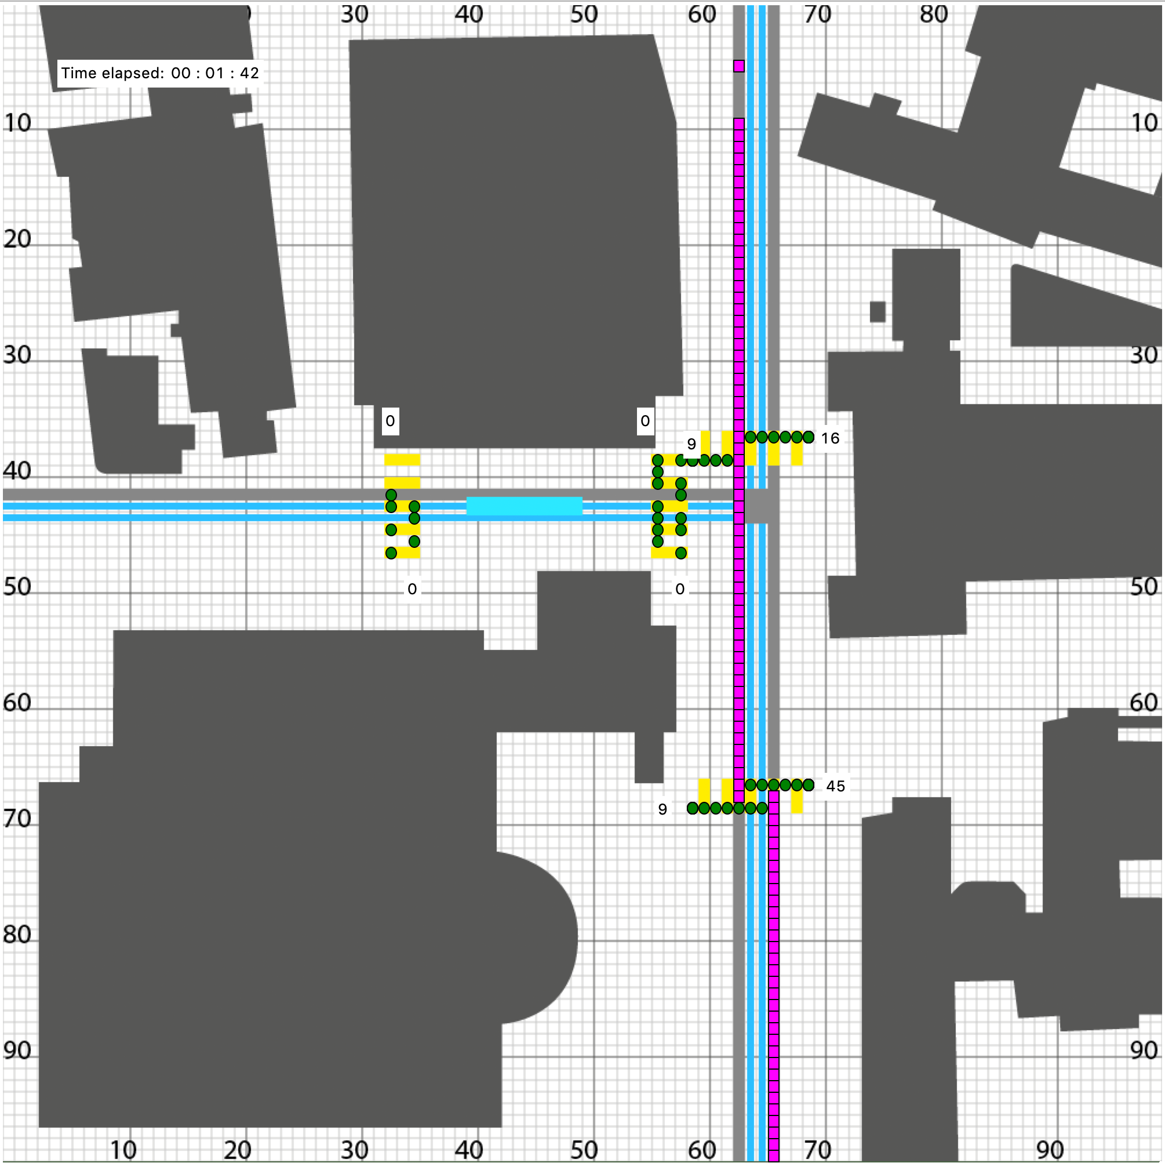
Simulation
Limitations of the simulation
Simplifications:
Agents behave “perfectly”
Agents strictly adhere to given paths
Short-sighted agents
Adaptability to a different Crossroad is limited
Critical Parameters
Too many pedestrians result in a deadlock
Notes:
- Only one pedestrian crossing at a time
Bild Deadlock

Slide 7
Performed Simulations
4 Different scenarios / times of day:
4 Different Traffic light waiting periods
N | O |  | L | I | G | H | T
3 | 1
4 | 2
1 | 5 |  |  |  |  | 2 | 5
Car Density
2 | 0 |  |  |  |  | 2 | 0
2 | 5 |  |  |  |  | 1 | 5
Pedestrian Density
Red and green times for pedestrians [s]

Slide 8
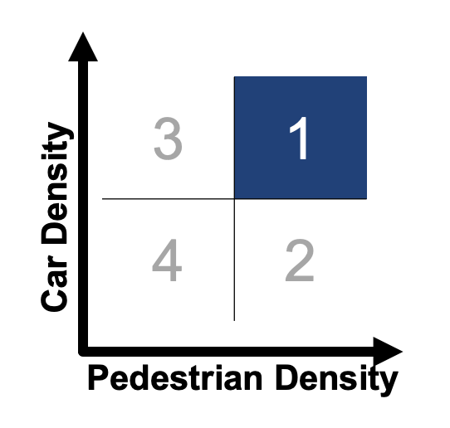
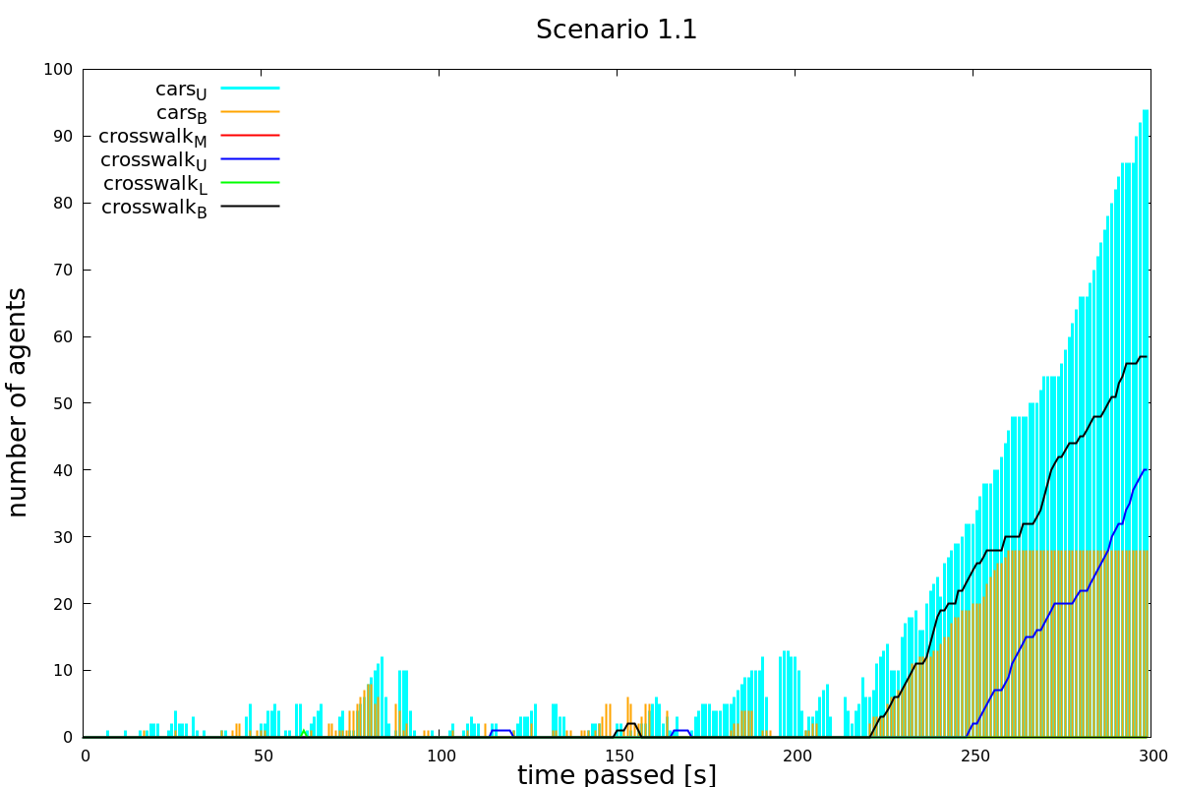
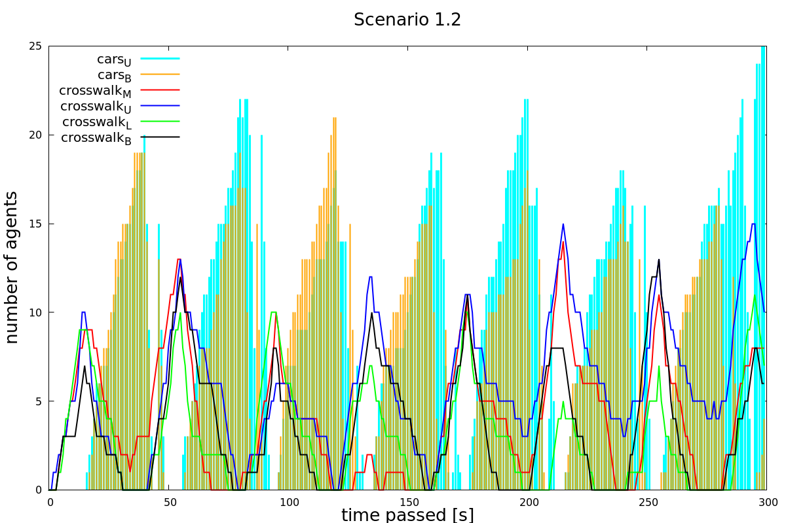
Results – Improvement
N | O |  | L | I | G | H | T
1 | 5 |  |  |  |  | 2 | 5
Notes:
Diagram erklären
Auf Achsenbeschriftungen hinweisen

Slide 9
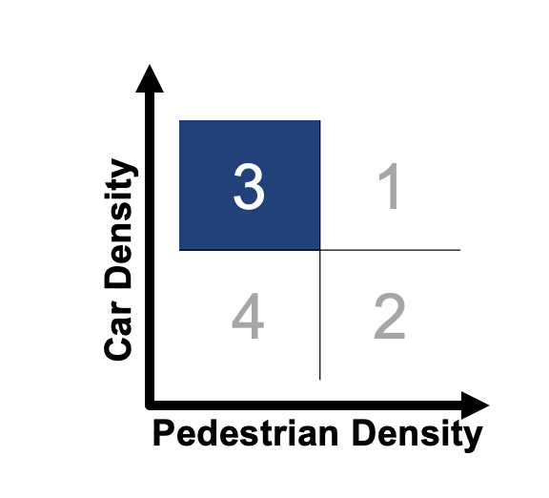
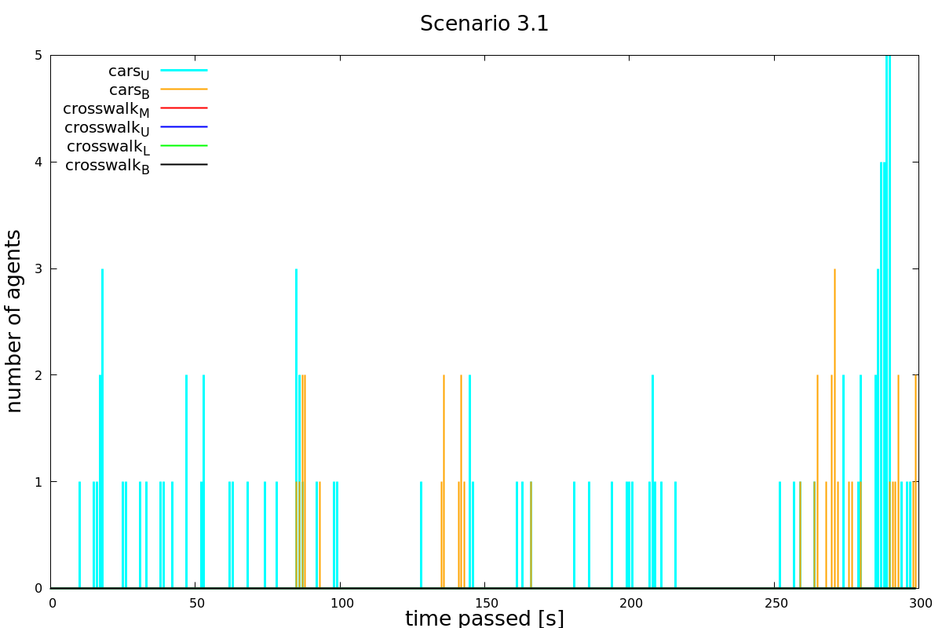
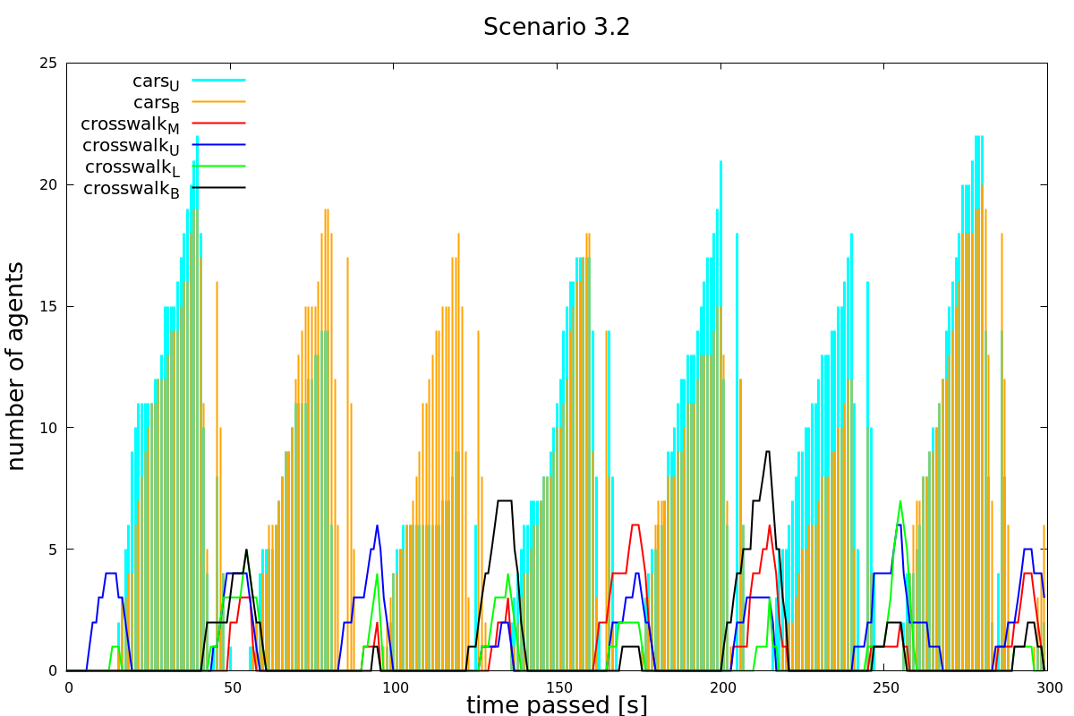
Results – Counterproductive
N | O |  | L | I | G | H | T
1 | 5 |  |  |  |  | 2 | 5
Notes:
Jérôme
- Still works; other scenarios where it doesn‘t work

Slide 10
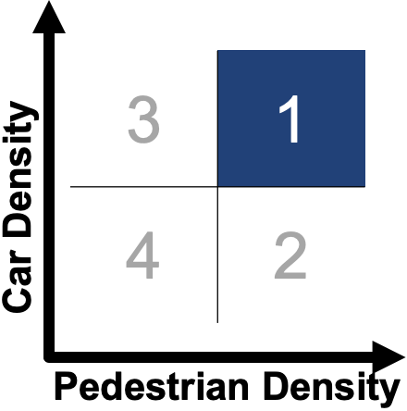
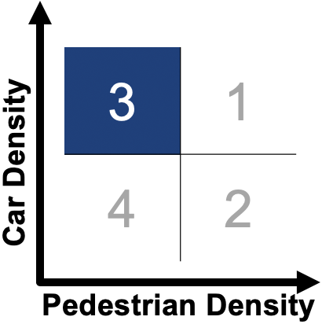
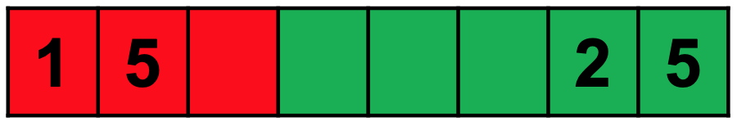

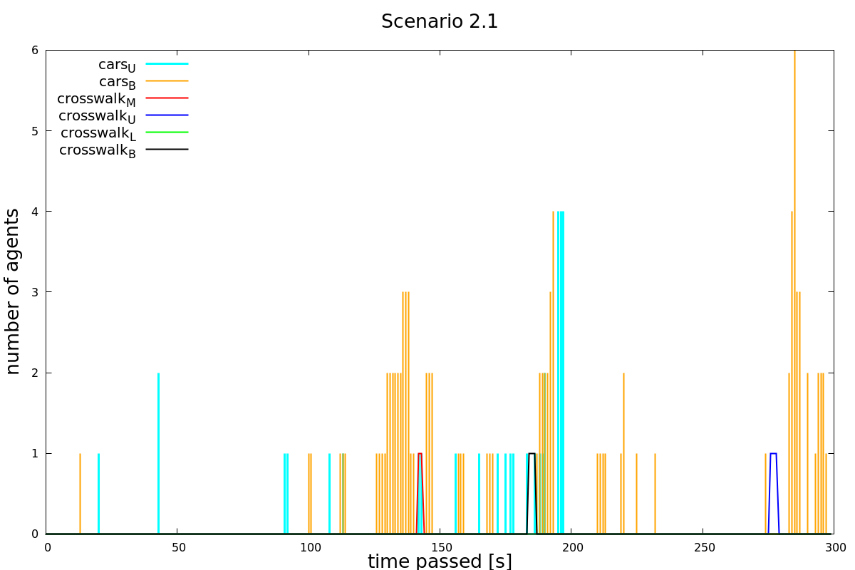
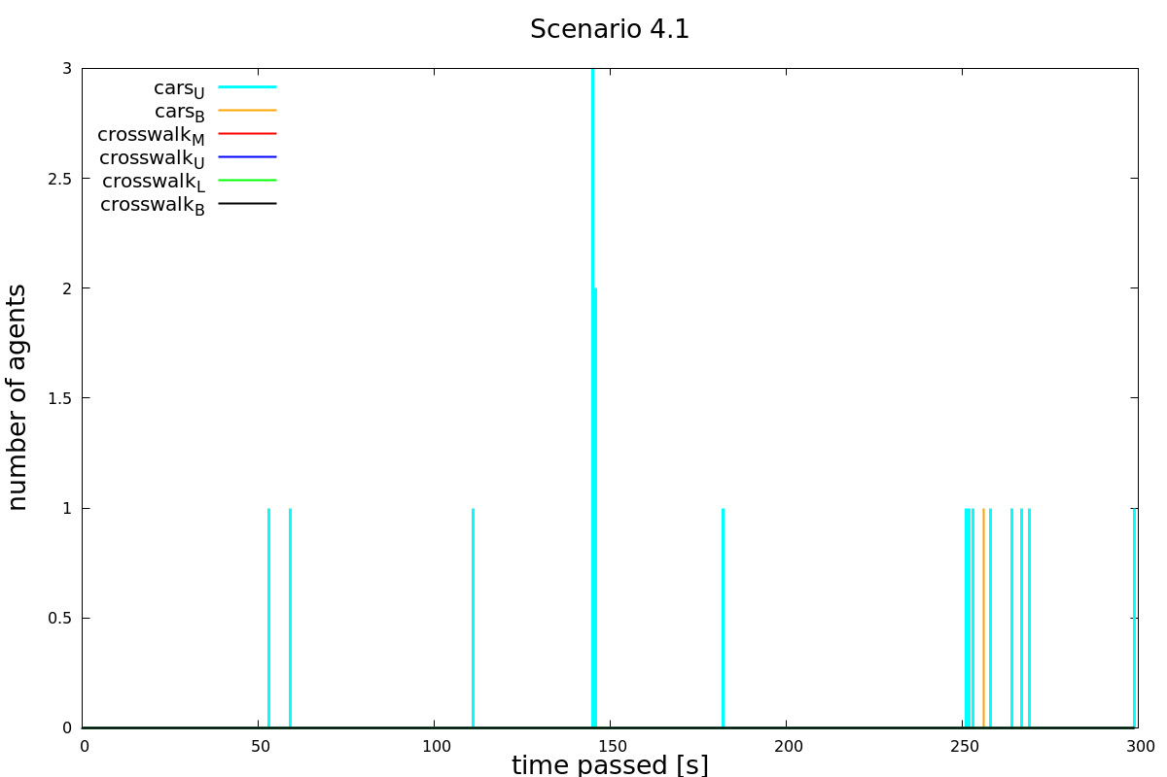
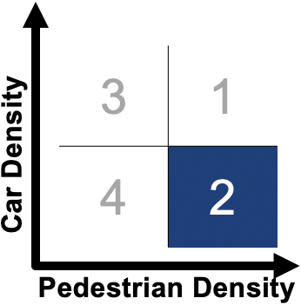
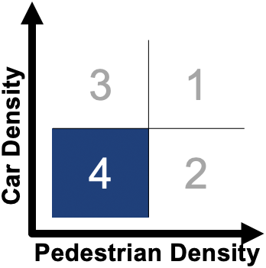
Results – Best Solutions
Notes:
Achsenskalierung
Beschriftung, was was ist

Slide 11
Conclusion
Key Questions
How good is the current solution?
Current situation works well in most cases
Could the situation be improved by adding traffic lights?
Only for situations with high densities of pedestrians and cars
Otherwise, counterproductive
What would be the best solution for all agents?
Traffic lights turned «ON» only for high densities of pedestrians and cars
Traffic lights turned «OFF» for all other scenarios
Notes:
Now let's answer our three key questions I mentioned at the beginning:
1.) The first question was "How good is the current solution":
As we saw during the presentation the current solution works well if we do not have high car and high pedestrian density
2.) Could the situation be improved by adding traffic lights?
The answer is yes but only if we have high car AND high pedestrian density. Otherwise it's counterproductive.
3.) What would be the best solution for all agents? Listen carefully this question sums up our project!
Traffic lights turned "ON" only for high densities of pedestrians and cars
Traffic light "OFF" for all other scenarios!

Slide 12
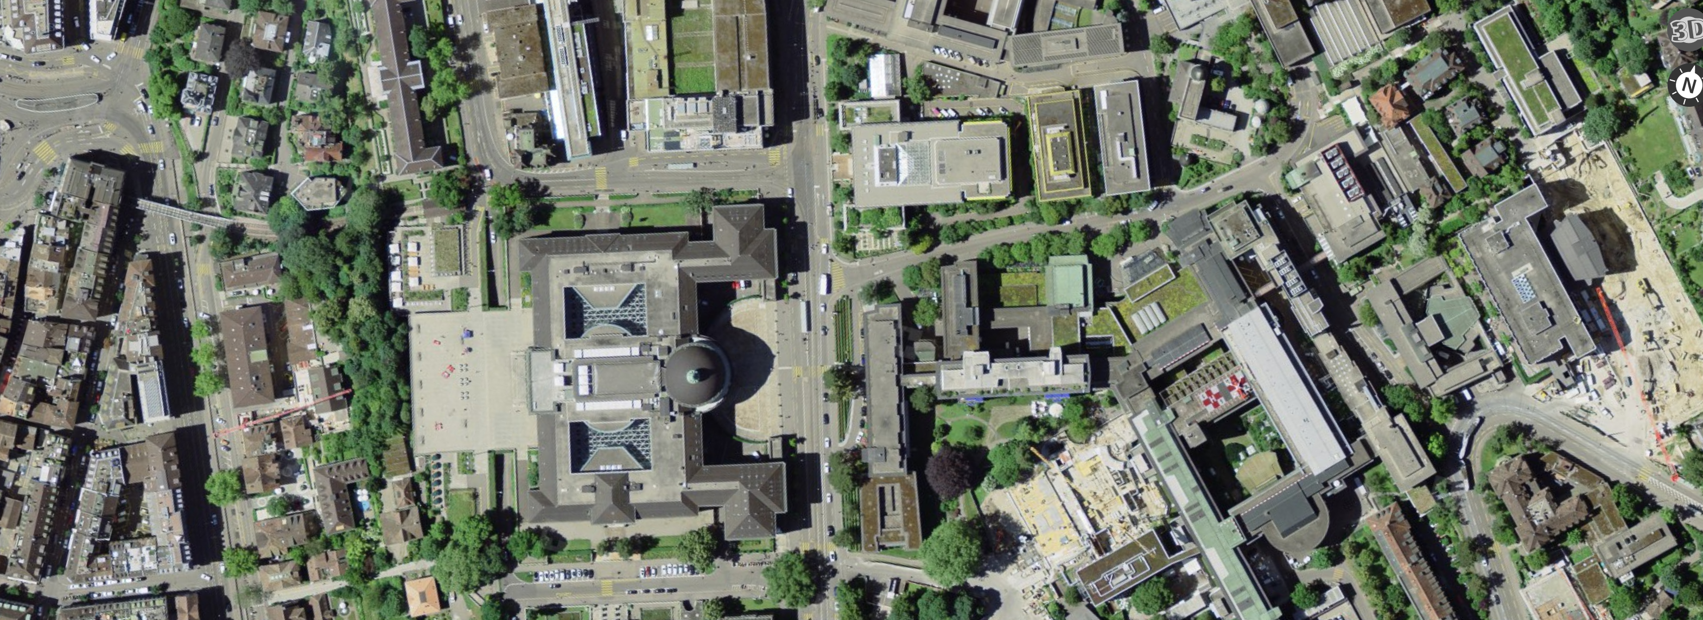
Thank you for your attention
Image: swisstopo

